Slide 1
Shopping customer segmentation
By Parkhat Bazakov
Last updated: 2/30/2023

Slide 2
Objective
Divide mall target market into approachable groups.
Create subsets based of a market based on demographics behavioral criteria to better understand the target for marketing activities

Slide 3
Data source
Secondary data
https://absentdata.com/data-analysis/where-to-find-data/
Steps taken
Perform EDA (Exploratory Data Analysis)
Use KMEANS Clustering algorithm to create segments
Use summary Statistics on the clusters
Visualize

Slide 4
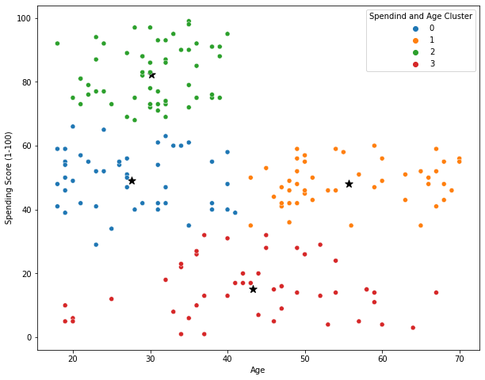
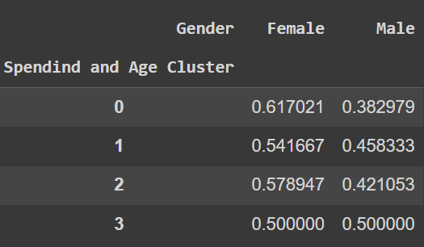
Results
Analysis showed 4 distinct segments of customers according to relationship to Age and Spending Score.

Slide 5
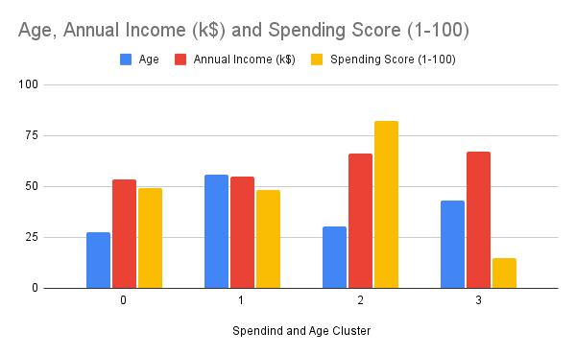
Clusters 2 shows the highest spending score with average age of 30. (50/50 gender ratio)
Cluster 0 and 1 with average ages of 27 and 55 shows the Spending score of 48 - 49 points.
Females prevail with 60/40 ratio in Gender of the customer.
Annual income seems to be irrelevant.

Slide 6
Conclusion
There is a negative correlation between Age and Spending score (-0.33)
Younger customers seem to spend more.
Campaign can be made to target an age groups of 18- 40.

